Slide 1
Family Violence Information Sharing Session 3 – How do I respond to a family violence information sharing request or share proactively?

Slide 2
Session agenda
Session 3
Reflection on Session 2
Objectives and learning outcomes
Sharing family violence information about your clients (responding to a request or sharing proactively)
Activity and case study – How do I assess whether it is appropriate to share and with who?
Resources
Agenda

Slide 3
Reflection on Session 2

Slide 4
Reflection on Session 2
Session 3
Activity
Recap of last session’s activity
How do I discuss family violence information sharing requirements with my clients?
Take some time to think back on your experience…
What was easy about practising these conversations?
What was difficult about it?
What did you learn that you can apply in real conversations with your clients about family violence information sharing?

Slide 5
Objectives and learning outcomes

Slide 6
Objectives
Session 3
Info
Know how to decide whether you should share family violence information.
Practise the steps you need to take to manage any family violence information shared.

Slide 7
Learning outcomes
Session 3
At the end of this session you will be able to:
Explain how to share family violence information about a client with another organisation.
Explain the considerations around what family violence information can be shared and with who.
Know where to locate resources that will help you to:
Seek further information about how to use the Family Violence Information Sharing Scheme in scenarios where you’re unclear what is appropriate.

Slide 8
Sharing family violence information about your clients (Responding to a request or sharing proactively)

Slide 9
Sharing family violence information about your clients Responding to a request or sharing proactively
Session 3
Info
Sharing family violence information is important so relevant services can work better to keep perpetrators in view and keep victim survivors (and their children) safe.
Information will only be shared where it is relevant to assess and manage the risks of family violence.
Who you can share family violence information with
You can share relevant information with a person from a prescribed Information Sharing Entity (ISE).
Remember: you can check if an organisation is an ISE using this ISE List we covered in Session 1).
Types of family violence information you can share
Risk relevant information is:
Information about family violence behaviours (risk factors) a perpetrator is using against an adult and / or children victim survivors or the circumstances in which those behaviours are occurring.
Information related to an adult and / or child's stabilisation and recovery (protective factors) from family violence.
Information related to a perpetrator’s stabilisation (stabilisation factors).

Slide 10
Sharing family violence information about your clients Responding to a request or sharing proactively
Session 3
How to share family violence information.
Info
Note: For any family violence information sharing you do, you should always ensure that you share information in a way that does not place the victim survivor at risk of further harm.
TIP: At any stage, if you are concerned or uncertain about the information sharing process, speak to your manager for guidance prior to making any decisions.
Step 1: Check the information is not excluded
Check the information you are being asked to share is not excluded and that sharing it does not contravene another law.
Remember: We covered this in more detail in Session 2.
Here’s a quick recap of what we discussed: Information classified as excluded information, if shared, could be reasonably expected to endanger a person’s life or result in physical injury, prejudice legal proceedings or a police investigation, contravene a court order, or is subject to legal professional privilege.

Slide 11
Sharing family violence information about your clients Responding to a request or sharing proactively
Session 3
How to share family violence information.
Info
Step 2: Check the information you are being asked to share, is being used for one of the two permitted purposes
If you’re not sure, you should check with your Family Violence Specialist Advisor and manager.
Sharing information for a family violence protection purpose means that you believe the information will help manage a family violence risk, including assessing ongoing risk. All ISEs can share for a protection purpose with all other ISEs.
Sharing information for a family violence assessment purpose means that the information is being used to establish and assess family violence risk posed by a perpetrator or alleged perpetrator. Information can be shared for this purpose only with Risk Assessment Entities, for example Child Protection and Specialist Family Violence Services.

Slide 12
Sharing family violence information about your clients Responding to a request or sharing proactively
Session 3
How to share family violence information.
Info
Step 3: If you’ve decided that it’s appropriate to share family violence information, you need to check that you can share information with the person requesting it
If you are sharing for a family violence protection purpose, check the ISE List to make sure their organisation is an Information Sharing Entity.
If you are sharing for a family violence assessment purpose, check the ISE List to make sure their organisation is listed as Risk Assessment Entity.
(Remember: we covered how to check the ISE List in Session 1.)
Important: If you don’t have a relationship with the person, you should do some extra checks to make sure they work where they say they do. For example, you could ask them to send you an email from their official work account before proceeding. This is to ensure that you are keeping information about victim survivors safe and secure. Think about taking the same care you would if you received a phone call from someone asking for your personal details, like your bank account.

Slide 13
Sharing family violence information about your clients Responding to a request or sharing proactively
Session 3
How to share family violence information.
Info
Step 4: Figure out if consent is needed to share the information. If it is, ask the relevant person for consent.
Remember: We covered the scenarios in which consent is or isn’t needed in Session 2 – you can go back and check slide 11 for more detail. We also practised having a conversation with our clients about consent in Session 2.
Step 5: Share the information, taking appropriate steps to ensure it is shared securely and document what and how you shared it.
We will cover this process in more detail in Session 5, but the key things to know now are that you should:
Familiarise yourself with your organisation's family violence information sharing policies and procedures, including how to record any information sharing activity.
Document the entity that requested the information and the worker you spoke with.
Document the information that was shared and any consent or views obtained, or the reason for sharing without consent/obtaining views.
If you refuse to share the information because it was not relevant, exempt or applicable consent thresholds were not met, set out reasons for refusal in writing and provide this to the requesting ISE.
Document the method of sharing, and if sent through email, whether encryption was used.

Slide 14
Activity and case study

Slide 15
How do I assess whether it is appropriate to share and with who?
Session 3
Info
The scenario
Lisa has self-referred to the Alcohol & Other Drugs (AOD) service for support with her increasing use of alcohol.
During the intake process, the intake worker asked MARAM screening questions about family violence. Lisa informed the service that there is an IVO in place against her former partner, Darren, with Lisa and both children Ben (aged 14) and Tara (aged 3.5 years) listed as the affected family members. There is a condition permitting Darren to have supervised contact with the children.
Following intake, a face-to-face assessment is booked. The assessment worker discusses the safety plan put in place with Lisa’s specialist family violence case manager. Lisa identifies that she has had issues with alcohol use in the past, however is relying on it more of late as she’s unable to sleep. Last week, her son Ben told her that he saw Darren in the school car park during recess when he was returning to class. Lisa is worried Darren will attempt to take Ben out of school during the day. Lisa isn’t sure how seriously Darren is taking their breakup and believes Darren thinks they’ve just had a fight and that things will go back to normal. As Darren is attending the school, Lisa is concerned that Darren will try to have unsupervised contact with Ben, despite the conditions on the IVO.
Lisa is drinking more than she used to and says she currently feels like it’s the only thing that relaxes her so that she can sleep. Lisa’s previous AOD treatment episode was 5 years ago when Ben was 9 and Tara wasn’t born yet. The last time Lisa accessed treatment she had a standard episode of AOD counselling. Lisa discusses the previous treatment episode’s circumstances, noting that she didn’t realise it at the time, but Darren’s controlling behaviour had made her nervous. He used to take her car keys and hide them while he was at work so she couldn’t use the car, having to walk or catch the bus to get 9-year-old Ben to primary school. It was around this time that Lisa started drinking more than usual.
Compared to Lisa’s alcohol use when she sought support 5 years ago, her alcohol intake has increased.
Lisa states her children are a motivating factor for her seeking support to reduce her alcohol intake. Lisa advises she is engaged with a child and family service but is hesitant for the AOD worker to make contact in case information about her treatment is shared as she is fearful of being judged as a “bad mother” due to her substance use.
This case study was developed by the Western Integrated Family Violence Committee (WIFVC) in June 2020. To enquire about this resource please contact wifvc@whwest.org.au

Slide 16
How do I assess whether it is appropriate to share and with who?
Session 3
Activity
Questions for discussion in small groups.
What is risk relevant information in this scenario?
In relation to:
The perpetrator
The victim survivor (adult)
The victim survivor (child/young person)
What would be the purpose of sharing information?
Family violence risk assessment
Family violence risk management
If you wanted to share this information with another service, what consent is required?
Consider how you might seek the views and wishes of the adult or child
victim survivor if it was appropriate, safe and reasonable to do so.
Refer back to the definitions or risk assessment and risk management on slide 11.
Refer back to the risk relevant information on slide 9.
How is sharing or requesting this information keeping the victim survivor safe?
How is sharing or requesting this information keeping the perpetrator in view?
Based on this information, has your understanding of the level of family violence risk changed?

Slide 17
How do I assess whether it is appropriate to share and with who?
Session 3
Activity
Group discussion
What were the key points from your small group discussions?
Were there any questions you found challenging to answer?

Slide 18
Resources

Slide 19
Organisation-specific resources
Session 3
Some useful internal resources are provided below. Try to visit each of them over the next week, so you are aware of what internal policies and procedures exist to support family violence information sharing.
Info
Resource name:
<Insert resource name here>
How it helps:
<Insert brief description about why this resource is helpful>
Location:
<Insert instructions or a link to access this resource>
<Include an image of the location or the resource>
Resource name:
<Insert resource name here>
How it helps:
<Insert brief description about why this resource is helpful>
Location:
<Insert instructions or a link to access this resource>
<Include an image of the location or the resource>

Slide 20
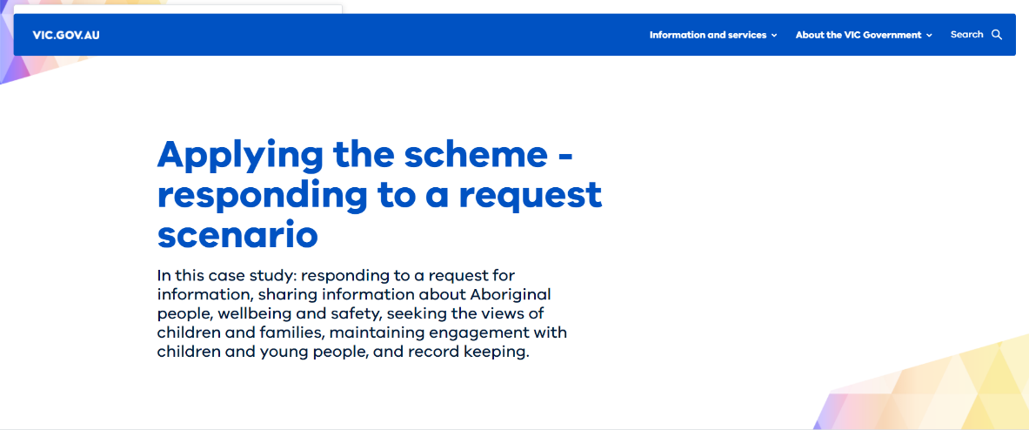
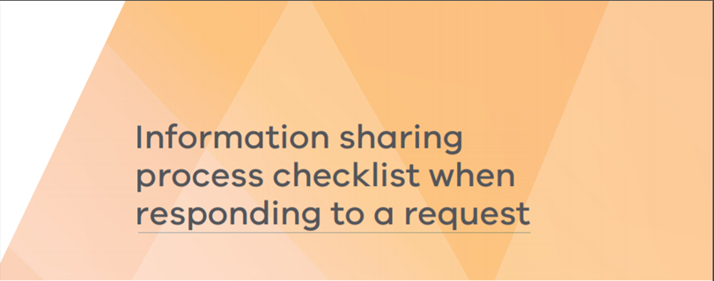
General resources
Session 3
Some additional resources are provided below. Try and familiarise yourself with them, so that you are aware of what additional information exists to support you as you adapt to the Family Violence Information Sharing Scheme.
Info
Resource name:
Applying the scheme - responding to a request scenario
How it helps: This resource steps through several scenarios relating to a single case study. It covers issues relating to sharing information about Aboriginal people, wellbeing and safety, seeking the views of children and families, maintaining engagement with children and young people, and record keeping.
Location: https://www.vic.gov.au/case-study-responding-information-request
Resource name:
Information sharing process checklist when responding to a request
How it helps: This resource provides a detailed list of things to consider when responding to a request to share family violence information. It provides some additional information to what is covered in the session material and so is a good place to look if you’re unsure about anything covered in the session background information.
Location: https://www.vic.gov.au/sites/default/files/2020-01/Information-sharing-process-checklist-when-responding-to-a-request.PDF

Slide 21
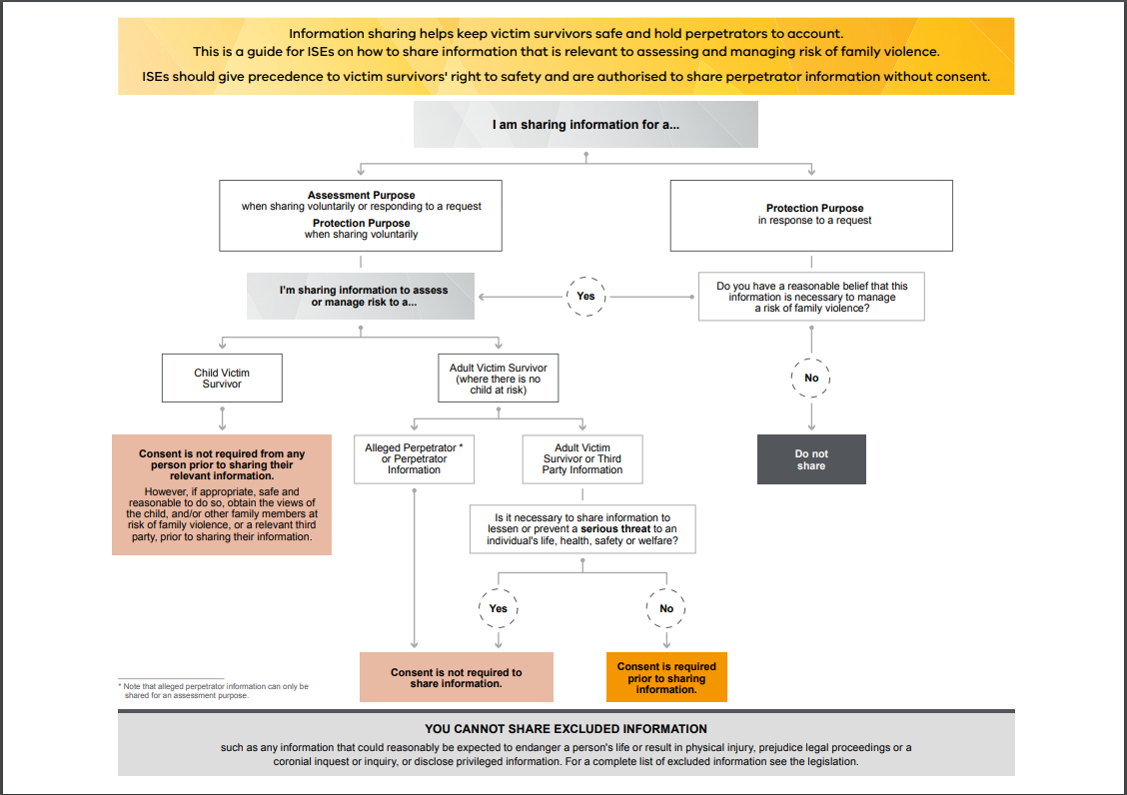
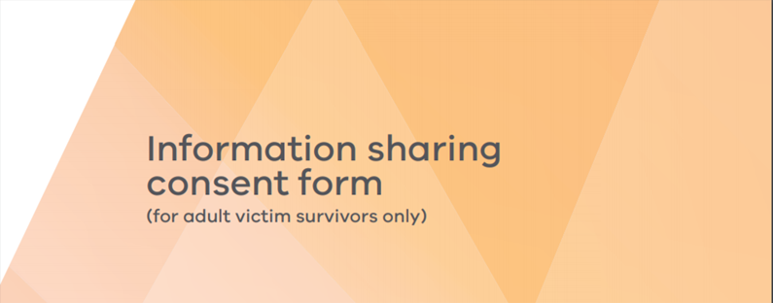
General resources
Session 3
Some additional resources are provided below. Try and familiarise yourself with them, so that you are aware of what additional information exists to support you as you adapt to the Family Violence Information Sharing Scheme.
Info
Resource name:
Information sharing consent form (for adult victim survivors only)
How it helps: This is a universal consent form developed by Family Safety Victoria, which can be used for recording consent to share information. You should also check whether your organisation has developed its own resources relating to requesting consent and recording consent.
Location: https://www.vic.gov.au/sites/default/files/2020-01/Information-sharing-consent-form-%28for-adult-victim-survivors-only%29.PDF
Resource name:
Guide for ISEs on how to share information
How it helps: A decision tree to step through whether to share family violence information and whether consent is required.
Location: https://www.vic.gov.au/sites/default/files/2019-01/A%20guide%20for%20ISEs%20on%20how%20to%20share%20information.pdf

